Slide 1
PHASE 1 PILOT — BENEFITS CASE
Reusing MITR AI to Deliver the Phase 1 Pilot
An already-built conversational analytics UX for Revenue, Cost, General Ledger, and Consolidation
Pilot value in weeks, not quarters — the same surface extends into Phase 2 and Phase 3
Companion to the Architecture Review Board deck · Finance Engineering · September 2026

Slide 2
WHY THIS, NOW
The Phase 1 Pilot needs a vehicle — one already exists
The roadmap calls for an AI-enabled UX plus 1–2 agents on the highest-pain stream, with a human-in-the-loop review workflow and a controls checkpoint.
Built, not hypothetical — MITR AI already does plain-language querying, generated insights, and governed data access across finance data. It is demoable today.
Wrap, don’t replace — it reads through governed feeds and sits above the ledgers. No change to systems of record or controls — the ARB’s own approach.
Weeks to first user — configuration plus one data connector, against the two to three quarters a pilot UX built from scratch would take.
Not throwaway — the same chat and dashboard surface is where Agent One’s drafting agents plug in for Phase 2.
Bottom line — piloting on MITR AI tests the UX and the controls model on real finance data before the larger build commits.
AI-Enabled UX for Finance Analytics & Automation · Phase 1 Pilot Benefits Case
2

Slide 3
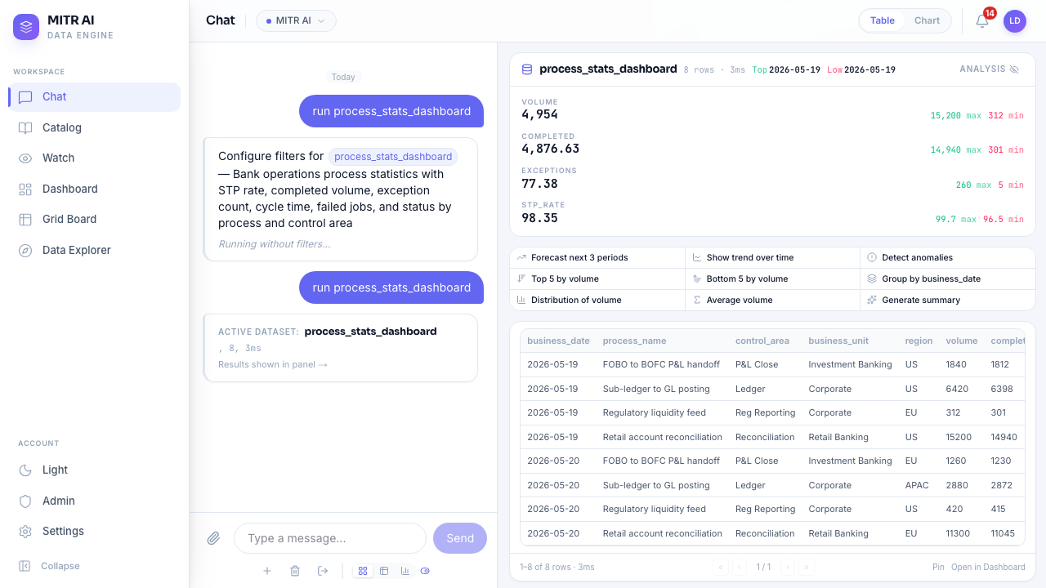
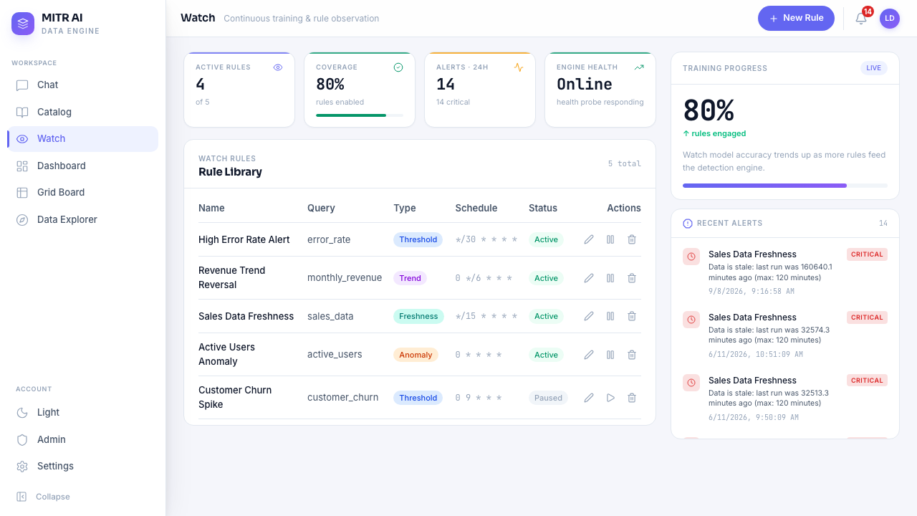
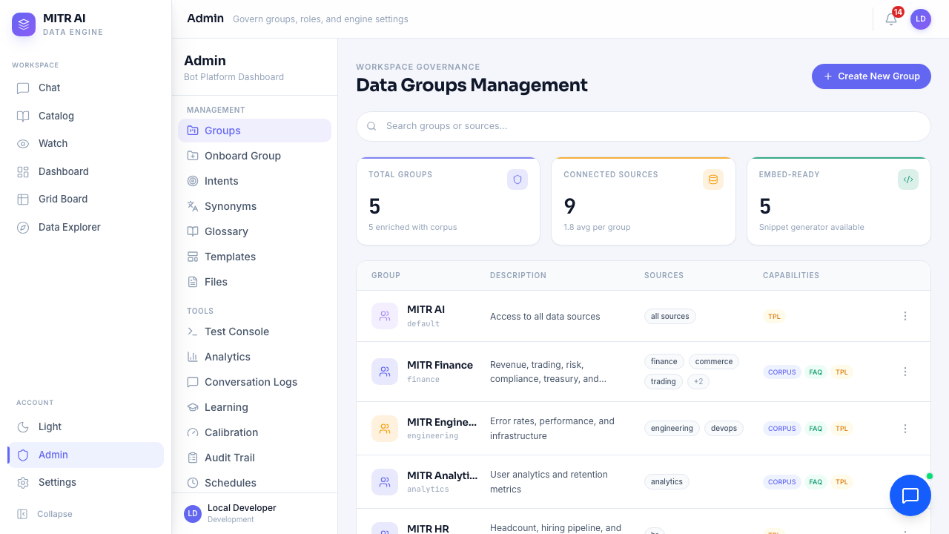
WHAT IT LOOKS LIKE
Seeing it: the pilot surface today
Live screens from the running platform — detail on the slides that follow.
Ask in plain language
Data, KPI tiles with deltas, and one-click analysis — no SQL, no report to build.
Monitors that run themselves
Freshness, threshold, trend, and anomaly rules raise alerts before anyone asks.
Governed from one console
Per-group data scoping, connectors, vocabulary, learning, and a full audit trail.
Captured from the running MITR AI build, using a mock finance dataset.
AI-Enabled UX for Finance Analytics & Automation · Phase 1 Pilot Benefits Case
3

Slide 4
THE SURFACE
A question in, data out — no SQL, no report build
WHAT TO NOTICE
Plain-language query returns a result set in about three seconds.
KPI tiles are computed automatically, each with its max / min range.
One click runs a forecast, trend, anomaly scan, group-by, or summary.
Table, chart, and drill-down live in the same view — nothing to export.
Chat → run process_stats_dashboard, filters skipped.
AI-Enabled UX for Finance Analytics & Automation · Phase 1 Pilot Benefits Case
4

Slide 5
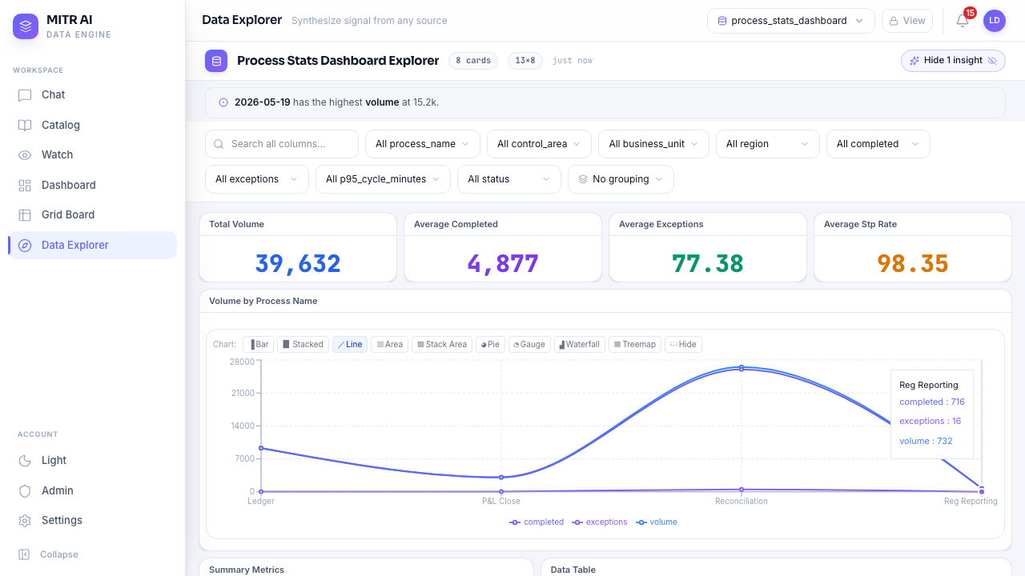
ANALYTICS LAYER
Insight appears before anyone asks for it
WHAT TO NOTICE
The top insight is surfaced on load — “2026-05-19 has the highest volume at 15.2k.”
KPI cards show direction and % change against the prior period.
Interactive chart, eight chart types, click any point to drill in.
Deterministic — no LLM in the path, every number is traceable to source.
Data Explorer → process_stats_dashboard.
AI-Enabled UX for Finance Analytics & Automation · Phase 1 Pilot Benefits Case
5

Slide 6
THE EXPERIENCE
The same before / after — most of it working today
The ARB’s target experience, mapped to what the pilot delivers now versus what Agent One adds later.
TODAY | WITH MITR AI (PILOT) | STATUS
A user pulls a variance report and scans for outliers by hand | Flagged variances are surfaced automatically, each with a plain-language explanation of the likely driver | Live today
“What’s driving the movement?” takes an analyst hours | Root-cause ranking by share of total, returned in the chat in seconds | Live today
Cross-stream reporting means exporting and combining data by hand | One semantic layer — cross-stream metrics are already assembled and ready | Live today
Stale or broken data is noticed only when someone stumbles on it | Anomaly and freshness monitors raise it proactively, with a full audit trail | Live today
Journal entries and eliminations are typed from source documents | Agents draft the entry from source data; a preparer reviews and approves | Phase 2 same surface
AI-Enabled UX for Finance Analytics & Automation · Phase 1 Pilot Benefits Case
6

Slide 7
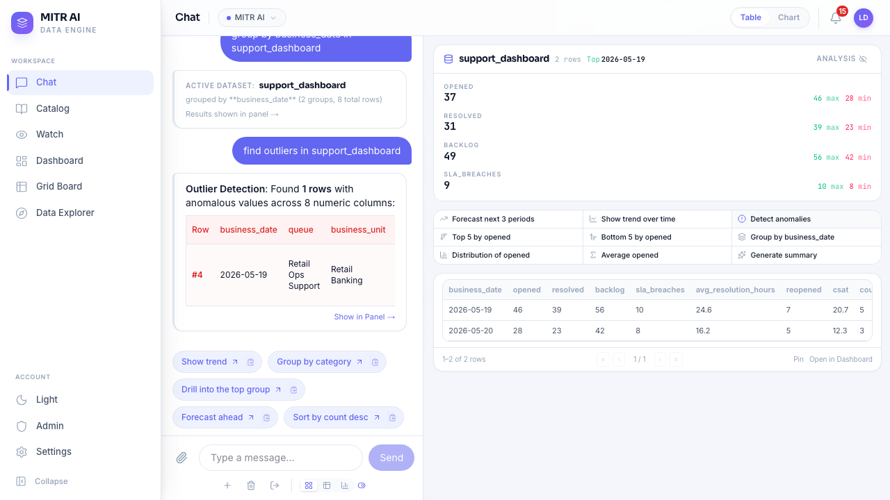
THE EXPERIENCE, IN ACTION
The platform flags the outlier and explains it
WHAT TO NOTICE
Outlier detection runs across every numeric column, unprompted.
Plain-language reason: “Resolved 16 vs avg 7.75 — unusually above average.”
The same mechanism drives variance explanation across all four streams.
A preparer reviews the finding; nothing is hidden or auto-posted.
Chat → “find outliers in support_dashboard.”
AI-Enabled UX for Finance Analytics & Automation · Phase 1 Pilot Benefits Case
7

Slide 8
HOW IT MAPS
MITR AI already delivers the UX and Analytics layers
Same layer model. The pilot delivers the UX layer and the Analytics layer — a named differentiator — and proves the review workflow Agent One will use.
UX Layer
PROVIDES — chat, live dashboards, and grid board; AI insight and automation status surfaced by default
Agent Orchestration — Agent One
PHASE 2 — out of pilot scope; the pilot proves the human-in-the-loop review workflow agents post through
Analytics Layer
PROVIDES — variance narratives, anomaly detection, and root-cause — deterministic, no LLM, fully auditable
EDP / Data Products (read-only)
CONSUMED — SQL Server, Oracle, CSV, and REST connectors — read-only, health-monitored, circuit-broken
Integration / Data Layer
PROVIDES — per-group data scoping — the only path the platform uses to reach source data
Systems of Record
UNCHANGED — Revenue, Cost, GL, and Consolidation sub-ledgers — untouched by the pilot
Guardrails already in the product — full audit trail for every action · role-based access across the UX layer · PII detection and masking with per-view audit · read-only data access enforced at the connector · end-to-end request correlation IDs. Aligns to SOX and existing control frameworks.
AI-Enabled UX for Finance Analytics & Automation · Phase 1 Pilot Benefits Case
8

Slide 9
CONTROLS
Freshness and anomaly rules run on their own
WHAT TO NOTICE
Rule types cover threshold, trend, freshness, and statistical anomaly.
Checks are scheduled — alerts are raised with no one watching the screen.
Every alert is timestamped and severity-tagged for the audit trail.
Rule coverage and detection-model training are tracked over time.
Watch → rule library and recent alerts.
AI-Enabled UX for Finance Analytics & Automation · Phase 1 Pilot Benefits Case
9

Slide 10
GOVERNANCE
Data scoping, connectors, and vocabulary in one place
WHAT TO NOTICE
Per-group data access — five groups over nine connected sources.
Capabilities are set per group (corpus, FAQ, templates).
Intents, synonyms, glossary, learning queue, and calibration all live here.
Full audit trail and conversation logs for every group.
Admin → Data Groups Management.
AI-Enabled UX for Finance Analytics & Automation · Phase 1 Pilot Benefits Case
10

Slide 11
DECISION NEEDED
What I’m asking
 | Build the pilot new | Pilot on MITR AI
Time to first finance user | Two to three quarters | Weeks
Cost | A new pilot build team | Config + one connector on an existing codebase
Risk | Unproven UX and controls | 150+ automated checks, load-tested, demoable now
Longevity | Pilot code may be thrown away | Same surface carries into Phase 2–3
THE ASK
Endorse MITR AI as the Phase 1 Pilot vehicle for the AI-enabled analytics UX.
Help confirm the pilot stream and a business sponsor to co-own the success criteria.
Approve a short spike to connect it to one real finance data product.
Success measured by: close-cycle time reduction • manual rework reduction • % of insights and entries AI-originated • adoption across finance teams.
AI-Enabled UX for Finance Analytics & Automation · Phase 1 Pilot Benefits Case
11

